Slide 1
Backend Engineering Project
Team Details:
Sushobhit Jain (2310992539)
Soni (2310992534)
Sohini (2310992533)
Tejasv (2310992547)
Faculty Coordinator: Dr. Pummy Dhiman
:
Chitkara University Institute of Engineering and Technology,
Chitkara University, Punjab

Slide 2
Table of Contents
Introduction
Problem Statement
Technical Details
Key Features
Project Highlights
Conclusion
References/Links used

Slide 3

Introduction
This project is a backend system that allows users to securely upload, store, share, and manage files—similar to a simplified version of Google Drive. Users can upload different types of files (documents, images, PDFs, videos), share them with other registered users (with either read-only or editable access), and manage permissions.
The system emphasizes authentication, security, file handling, and role-based access control, making it a real-world inspired project that demonstrates strong backend development skills.
Users can share files with specific registered users using their email IDs. Shared files appear in the “Shared With Me” section for easy access.
Each file has metadata such as filename, file type, size, owner, and shared users stored in MongoDB for quick search and retrieval.[1]

Slide 4
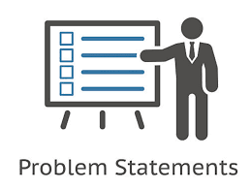
Problem Statement
In today’s digital environment, individuals and organizations rely heavily on file storage and sharing platforms to manage documents, images, videos, and other resources. While established services like Google Drive and Dropbox exist, they are often complex, require significant infrastructure, and are tightly integrated with large ecosystems. For small-scale applications, startups, or educational purposes, there is a clear need for a lightweight, customizable, and easy-to-deploy backend system that provides secure file management and sharing functionalities.
Most existing basic file upload systems only allow simple storage without critical features like authentication, role-based permissions, or sharing capabilities. This creates challenges in ensuring data privacy, controlled access, and scalability. Users need a reliable solution where they can upload files securely, share them with specific people, and manage permissions without depending on large enterprise solutions.
Therefore, the problem is to design and implement a backend system that offers secure authentication, efficient file uploads, file sharing with controlled access, and robust data management. Such a solution not only meets the needs of small-scale use cases but also provides developers an opportunity to learn the core principles behind large-scale storage systems like Google Drive.[2][3]

Slide 5
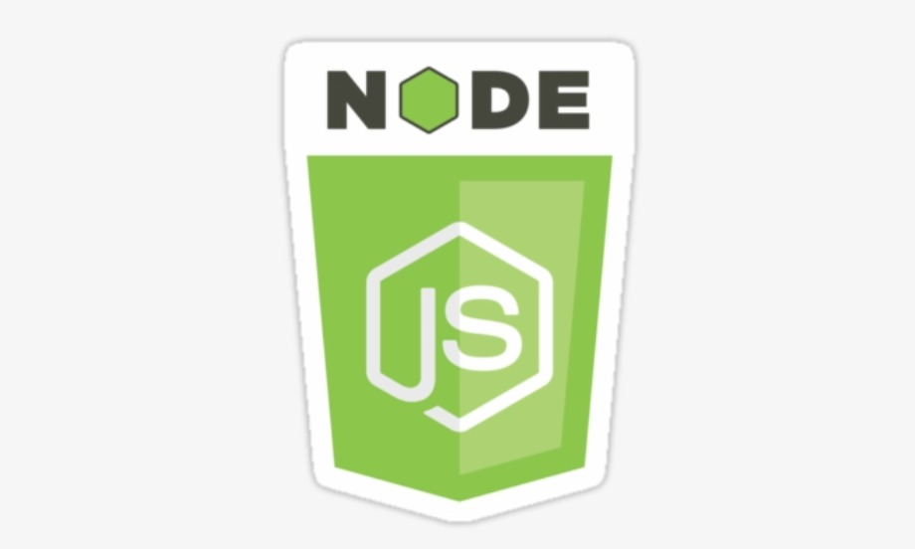

Technical Details
Our project is built using Node.js with several powerful libraries and frameworks.
We used Express for building a fast and scalable backend API, along with Mongoose for seamless interaction with MongoDB.
For authentication and security, we integrated bcryptjs for password hashing and jsonwebtoken (JWT) for token-based authentication.
Multer is used to handle file uploads, while CORS ensures secure communication between frontend and backend.
Additionally, dotenv is used for managing environment variables securely.
This stack provides a strong foundation for developing a reliable and secure application.[2]

Slide 6

Key Features
Secure Authentication – JWT-based login/signup with bcrypt password hashing.
File Upload & Storage – Upload files (PDFs, images, videos, docs) using Multer.
File Management – View, download, and delete files (owner only).
File Sharing – Share files with other users via email with controlled permissions.
Search & Filter – Find files by name, type, or upload date.
Access Control – Owners have full rights; shared users can only view/download.

Slide 7
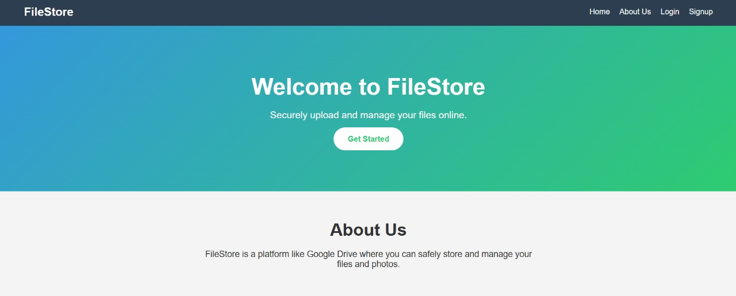
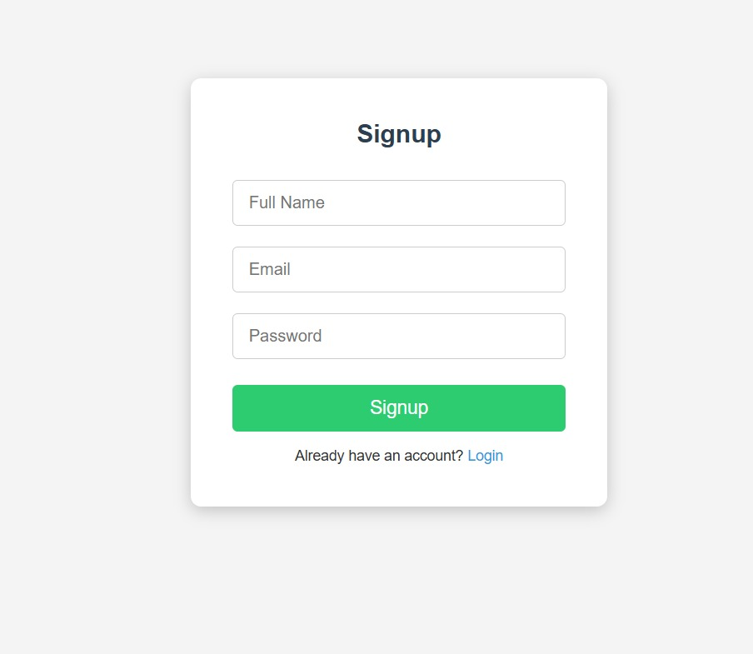
Project Highlights

Slide 8

Conclusion
The File Storage & Sharing Service (Mini Google Drive) provides a secure, scalable, and easy-to-use backend solution for managing files. It covers essential real-world features like authentication, file uploads, sharing, and access control, while remaining lightweight and customizable.
By implementing JWT authentication, role-based permissions, and file sharing, the project demonstrates how complex storage systems can be designed in a simplified manner. It also gives developers hands-on experience with Node.js, Express.js, MongoDB, and cloud storage integrations, making it highly valuable for learning and professional portfolios.

Slide 9
References/Links used
[1] M. P. Stević, “Enhancing m-learning using GridFS for storing and managing digital content,” OJAKM, vol. 2, no. 1, pp. 59-68, 2014.
[2] R. S. Sandhu, E. J. Coyne, H. L. Feinstein, and C. E. Youman, “Role-Based Access Control Models,” IEEE Computer, vol. 29, no. 2, pp. 38-47, Feb. 1996 .
[3] D. F. Ferraiolo, R. Chandramouli, D. Kuhn, and R. Sandhu, “A Role-Based Access Control Model and Reference Implementation,” ACM Transactions on Information and System Security, vol. 2, no. 1, pp. 34-64, Feb. 1999.

Slide 10


